Slide 1
Chess Games Analysis
Joseph Arney, Ravi Kiran, Jake Muller, Nathan Veatch

Slide 2
Background
Topic: Chess Games Analysis
What is chess?
Notes:
Chess is a game of pattern recognition
Machine learning excels at detecting macroscopic patterns in data
Goals
Use statistical and machine learning analysis on a large dataset of chess games
Answer broad questions about how chess is played
Apply results to our own games to become better players

Slide 3
Technologies/Tools Used
Languages
Python
SQL
Database
PostgreSQL
Database Interface
PgAdmin 4
Preprocessing
Jupyter Notebook
Pandas
Dashboard and Visualization
Tableau
Presentation
Google Slides
Machine learning
Tensorflow library
Custom Tables
Excel
Communication
Zoom
Slack
Notes:
Python: Python is a high level general-purpose programming language.
SQL: standardized programming language that is used to manage relational databases and perform various operations on the data in them.
PostgreSQL: free and open-source relational database management system emphasizing extensibility and SQL compliance.
PgAdmin 4: complete rewrite of pgAdmin, built using Python and Javascript/jQuery.
Jupyter notebook: web-based interactive computing platform
Pandas: pandas is a software library written for the Python programming language for data manipulation and analysis.
Tableau: data visualization tool
Zoom: met during class times and twice on weekends
Slack: communicate during the week

Slide 4
Datasets
Dataset 1
Random assortment of roughly 20,000 games played on lichess.org, pulled via Lichess API
Dataset 2
6.25 million chess games played on lichess.org in July 2016 (randomly sampled for 1 million games)
Notes:
Both datasets contained similar columns:
Date/time of game
Identity of players
Rating of players
Winner
Moves

Slide 5
Statistical Analysis Questions
What is the probability of win/lose/draw by color, and does that change by rating bracket?
What is the distribution of rated titles?
What is the most common opening overall, and by rated title?
What opening has the highest win chance by color?
What is the average number of games played per day for each rated title?
Notes:
Statistical questions we wanted to answer.

Slide 6
Machine Learning Question
Does the opening matter? If an opening is defined by the first 5 moves, can an ML model predict (with a high degree of accuracy) a winner from a color's first five moves?
Notes:
Does the opening matter?
If an opening is determined by the first five moves, can a machine learning model predict (with a high degree of accuracy) a winner from a color’s first five moves?
Given an opening, player color, player rating difference, and number of moves, can a winner be predicted with a machine learning model?

Slide 7
Data Exploration Phase
Adjusting columns for continuity between datasets
Remove duplicate rows or rows missing data
Clean up data by standardizing moves
Notes:
Does the opening matter?
If an opening is determined by the first five moves, can a machine learning model predict (with a high degree of accuracy) a winner from a color’s first five moves?
Given an opening, player color, player rating difference, and number of moves, can a winner be predicted with a machine learning model?

Slide 8
Data Analysis Phase
Create machine learning model
Perform statistical analysis
Visualize results
Notes:
Creation of machine learning model
Converted moves (categorical, main feature) into integers for use in model
Applied standard scaler
Split into training and testing data
Created hidden layer and output layer
Preliminary run of model with five epochs
Perform statistical analysis
Charts made in tableau
Visualization
Tableau

Slide 9
Machine Learning Model
Model type: Neural Network
Features
Moves
Target
Outcome
Notes:
Creation of machine learning model
Converted moves (categorical, main feature) into integers for use in model
Applied standard scaler
Split into training and testing data
Created hidden layer and output layer
Preliminary run of model with five epochs
Perform statistical analysis
Charts made in tableau
Visualization
Tableau

Slide 10
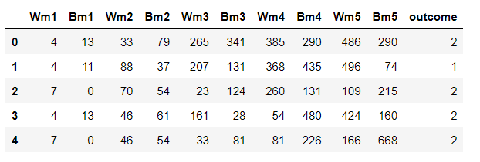
Preprocessing and Feature Engineering
Standardized outcome column
Cleaned up moves columns
Notes:
The “winner” column was standardized to say either “white”, “black”, or “draw”, as it was previously a mixture of that and notation (1-0,0-1,½-½)
Turn numbers and chess engine evaluations were removed from the list of moves
To answer our question, we needed to get the opening moves from our dataset
Our features were already in their own column (“moves”):
The special symbols used in chess notation needed to be removed
The first 10 moves were then split into their own columns, and labeled Wm1-Wm5 and Bm1-Bm5 (white and black moves 1-5,respectively)
These columns were then separated into their own “moves” dataset
Dropped remaining moves
Each unique move was then assigned its own unique number for each feature column (ex. “E4” was 0), and our “result” label column was also transformed with a unique number for each result (0,1, or 2):

Slide 11
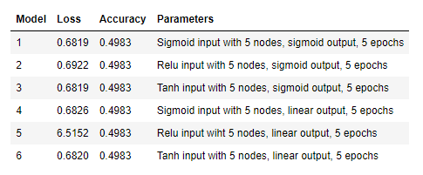
Machine Learning - Stage 1
Notes:
Stage 1 - creating the model
Testing input layer (sigmoid, relu, tanh) and output layer activation functions (sigmoid, linear)
Accuracy constant - roughly the probability of guessing the winner at random
Games typically last much longer than 10 turns, so opening 10 may not have enough impact to be a good indicator of winner
Loss
Ruled out linear output - output from sigmoid function tends to be very close to 0 or 1; since we pose a binary question sigmoid is best choice
Ruled out relu - greatest loss score among the 6 models
Conclusion - sigmoid output, either sigmoid or tanh input, next test is adding an additional input layer

Slide 12
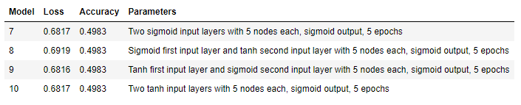
Machine Learning - Stage 2
Notes:
Stage 2 - additional input layer
Keeping all other factors the same, went from 1 input layer to 2
All possible combinations/orders of sigmoid and tanh
Accuracy remains constant
No significant changes in loss - difference between greatest and least loss is 0.0003
Therefore:
Adding a second input layer is not likely to improve model performance
Still cannot draw conclusions regarding efficacy of sigmoid and tanh as activation functions
Next: change number of nodes

Slide 13
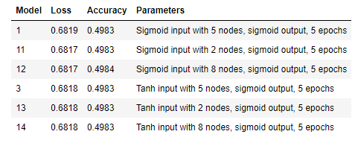
Machine Learning - Stage 3
Notes:
Stage 3 - changing number of nodes
Ran single-layer sigmoid and tanh inputs with 2 and 8 nodes, with original runs shown for reference
Accuracy and loss more or less uniform again
Accuracy - one changed by 0.0001, not significant
Loss - range of 0.0002 not significant
Unable to attribute number of nodes to model performance
Sigmoid and tanh still show no appreciable difference
Last stage - number of epochs

Slide 14
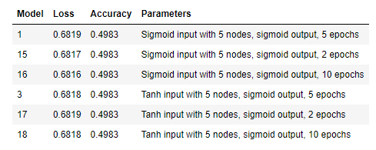
Machine Learning - Stage 4
Notes:
Stage 4 - changing number of epochs
Ran single-layer sigmoid and tanh inputs with 2 and 10 epochs, with original runs shown for reference
Once again, no significant differences, so number of epochs seems to have little to no impact on model performance

Slide 15
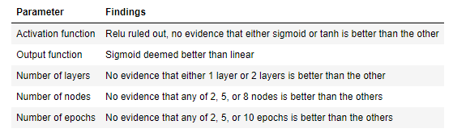
Machine Learning - Summary
Notes:
Summary - pull up tableau graph with table of models
We could draw conclusions about 2 of the 5 parameters
Relu ruled out as activation function, no evidence that sigmoid or tanh is better than the other
Sigmoid > linear for output function
Could not draw conclusions about the remaining 3
Number of layers, number of nodes, number of epochs all showed no significant change in performance when parameters were adjusted
Results point to neural networks being an ineffective means of predicting the winner of a game of chess given the first 10 moves
Chess is a complex game - outcomes are difficult to map as every turn begets an exponentially branching tree of possibilities
As the number of turns grows, the probability of the current board state occurring given the opening of the game dramatically drops, making it harder to predict
Ultimately, the accuracy remaining very close to 0.5 points to the answer to our original question, “can we predict the winner of a game of chess given the first 10 moves?”, appears to be No

Slide 16
Machine Learning - Future Analysis
Other machine learning methods
Principal Component Analysis
Repetition of analysis with more input features
Notes:
We only used a neural network - other types of machine learning may be more useful in answering our question
E.g. decision tree, which closely mimics the flow of a game of chess, but would need to be inordinately large to accurately capture every possible combination of moves
PCA reduces the number of input features - incorporate more than 10 moves without the number of input features reaching a problematically large number
More input features
Unrealistic for someone with the resources of a student without access to supercomputing to perform this same analysis with, say, the first 50 turns of a game
We lack the computing power and the time
Given enough time/computing power, this study could potentially be expanded to include more than 10 moves
Would either corroborate our conclusions or show that neural network may be a viable solution

Slide 17
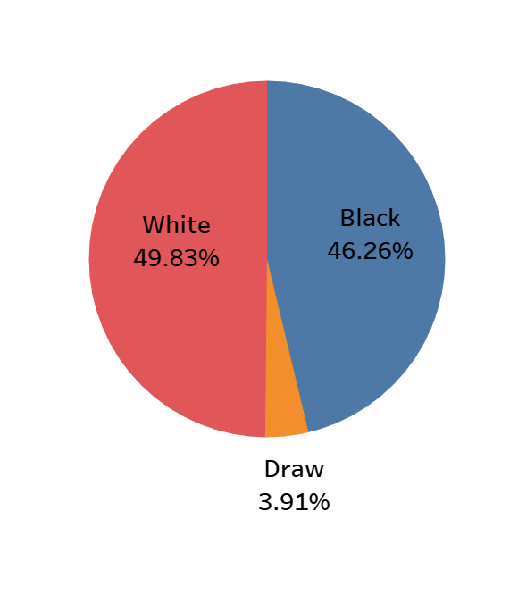
Win Percentages (by Color)(Tableau)
Notes:
-Based off ~850k games
-White slightly favored to win overall by ~3.5%
-3.5% difference stays relatively constant until the GM level, at which it drops to ~0.5%
-Draw percentage also goes up in master and GM, from ~4% to ~6% and ~7% respectively

Slide 18
Opening Frequency (Tableau)
Queen’s Pawn Game
French Defense
Sicilian Defense
King’s Pawn Game
Polish Opening
Notes:
-Top 5 openings consistent regardless of rating, they just swap around
-King’s pawn game probably opening everyone learns first, which is why it is most common for novices, then gradually becomes less common as ratings get higher
-Polish opening very non-traditional, and yet common at both the top and bottom of the ladder

Slide 19
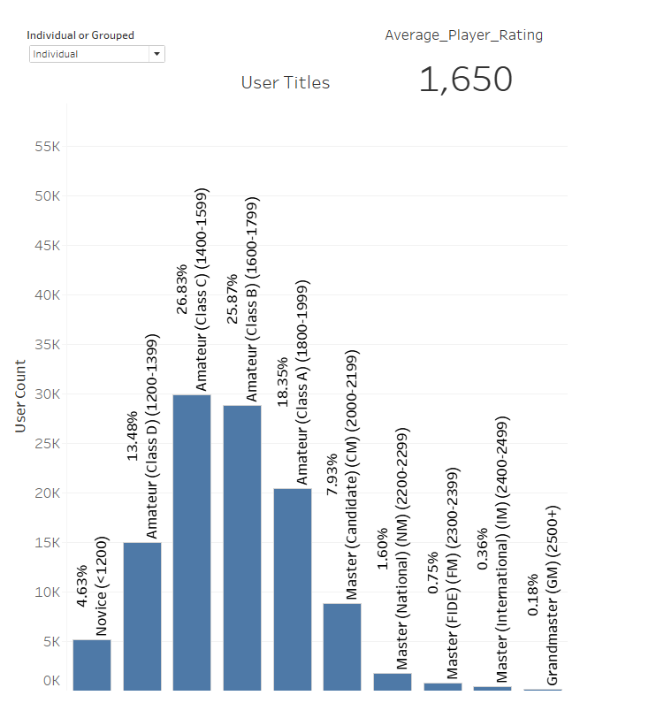
Chess Title Frequency (Tableau)
Notes:
-Based on ~100k unique users
-Overall average rating is 1650
-Graph peaks in the middle of the amateur rank, then drops off significantly towards GM
-For reference, middle amateur peaks are ~25k, & GM is ~200

Slide 20
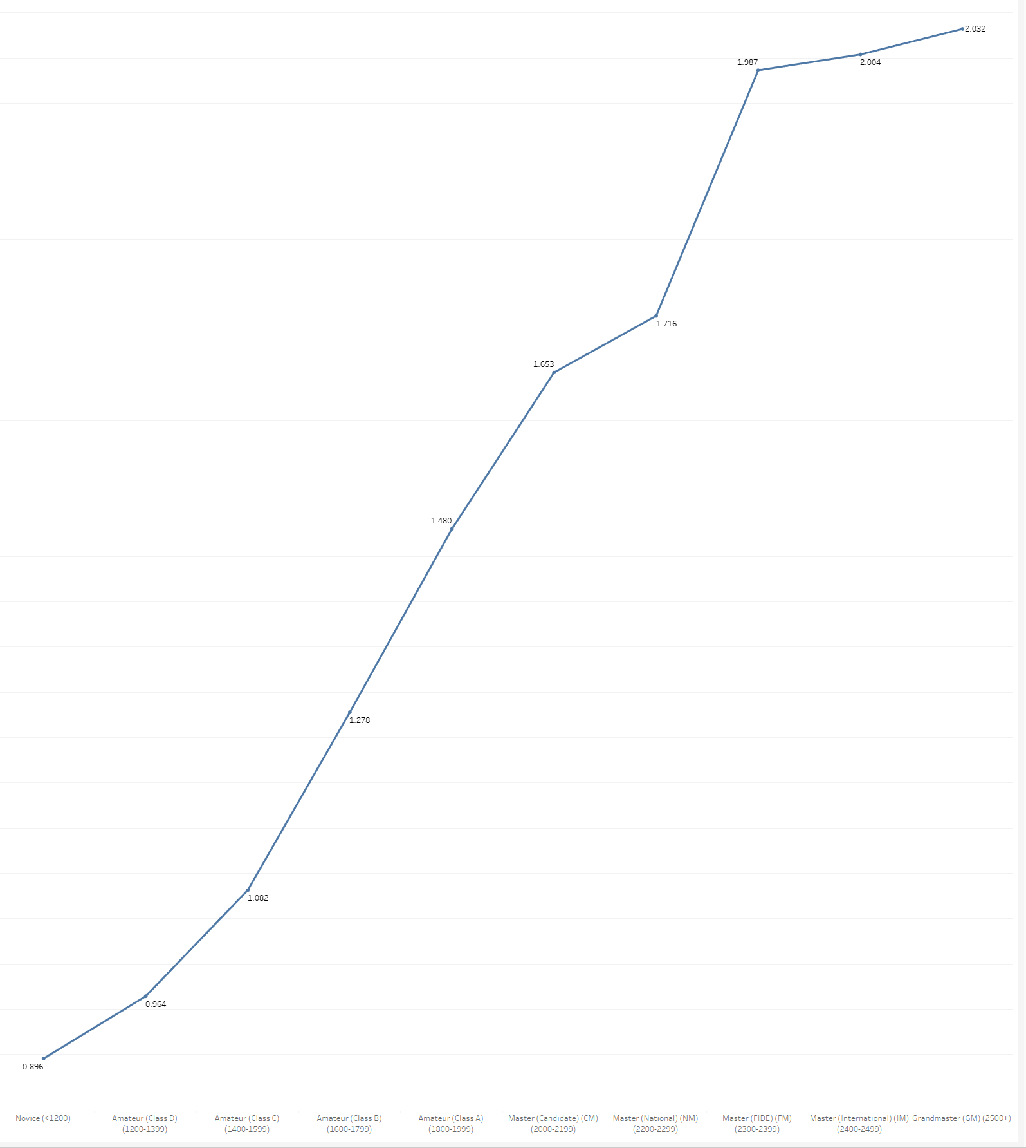
Avg Games/Day (by Title) (Tableau)
Notes:
-Unique users list simplified to users whose games all occurred in the same month (negligible loss, ~110k to ~105k), then days played and games played grouped by title
-Unsurprisingly, games/day increases as rating/title increases, from <1 game/day at the novice level, to ~2 games/day at the GM level

Slide 21
Best Openings (Black) (Tableau)
Vienna Gambit
Old Benoni Defense
Benko Gambit
Polish Opening
Benoni Defense

Slide 22
Best Openings (White) (Tableau)
King’s Knight Opening
Queen’s Gambit
Catalan
King’s Gambit
Two Knights Defense

